Slide 1
SLEEP HEALTH INFLUENCED BY LIFESTYLE FACTORS
Professors:
Petre Caraini
Daniel Traian Pele
Wolfgang Hardle
Team Members:
Research Methods - Project
IMBA, 2nd Year, 2023-2024
Torjescu Ana-Maria
Dumitru Laura-Alexandra
Costea Cristina-Bianca

Slide 2
INTRODUCTION
Sleep is a fundamental determinant of health, yet its quality is often compromised by lifestyle factors. This study aimed to investigate the relationship between sleep health and lifestyle factors, specifically sleep duration, physical activity level, and stress.
Using a dataset of a sample of 374 , we employed descriptive analytics, visualized through scatterplots, to explore initial associations between the variables. Moreover, an OLS regression model was developed to quantify these relationships and predict the quality of sleep from the selected lifestyle factors.
Keywords: Sleep Quality, Lifestyle Factors, Physical Activity, Stress, Regression,Sleep Duration
01

Slide 3

DATASET
The Sleep Health and Lifestyle Dataset comprises 374 rows and 13 columns, covering a wide range of variables related to sleep and daily habits:
Details such as: gender, age, occupation, sleep duration, quality of sleep, physical activity level, stress levels, BMI category, blood pressure, heart rate, daily steps, and the presence or absence of sleep disorder.
Main Sleep Metrics:
Sleep Duration,
Quality, and
Factors influencing Sleep Patterns:
- Lifestyle factors(physical activity levels, stress levels, and BMI)
- Cardiovascular factors (blood pressure and heart rate)
- Sleep disorder factors (insomnia and sleep apnea).
02

Slide 4
RESEARCH QUESTIONS
Based on these data, four research questions have been developed:
What is the correlation between the main factors of the dataset?
What is the relationship/correlation between Sleep - Physical Activity Level? What about Sleep Duration and Stress Level?
What is the linear regression between quality of sleep and sleep duration and to what extent the predicted values differ from actual values?
To what extent does the data analyzed represent “a good fit” for the model?
03

Slide 5
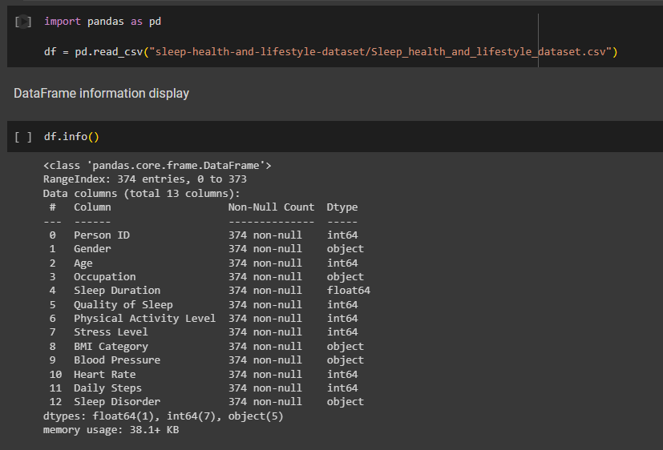
1) IMPORTING DATA
04

Slide 6
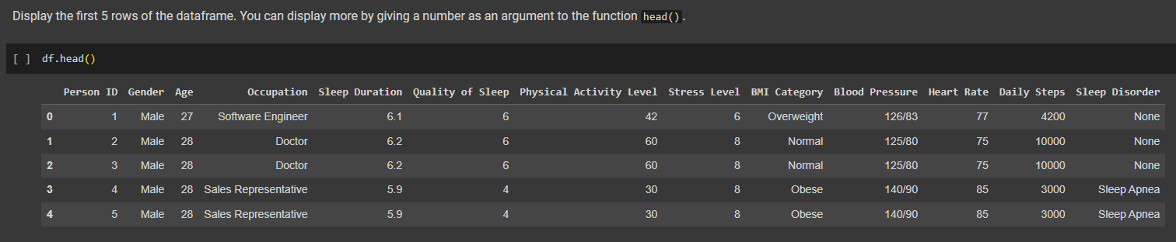
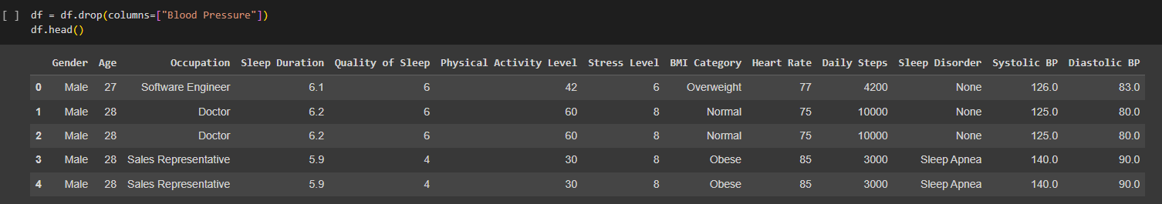
1) DATA
05

Slide 7
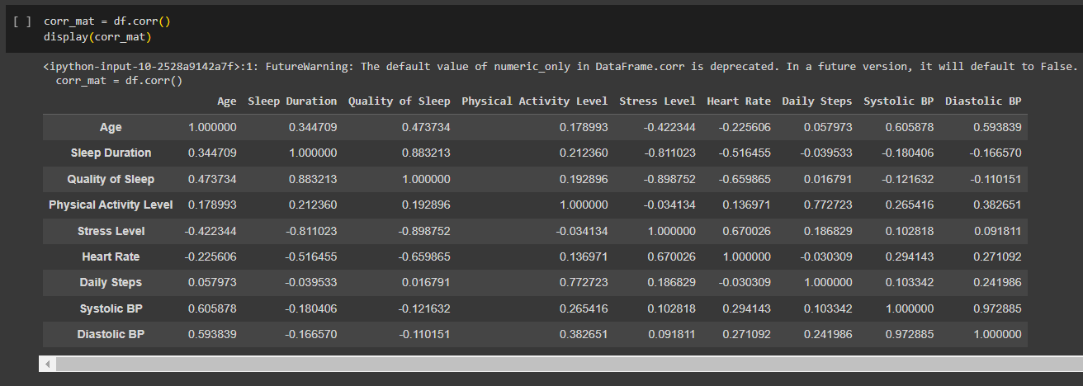
2) CORRELATION MATRIX
06

Slide 8
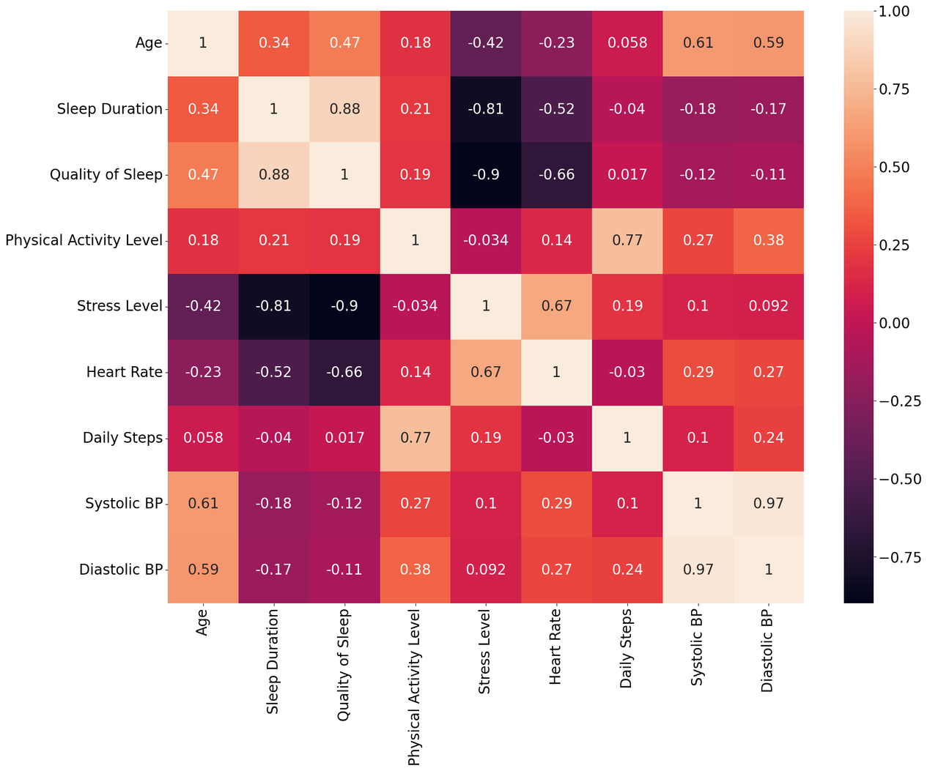
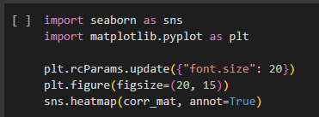
3) CORRELATION HEAT MAP
07

Slide 9
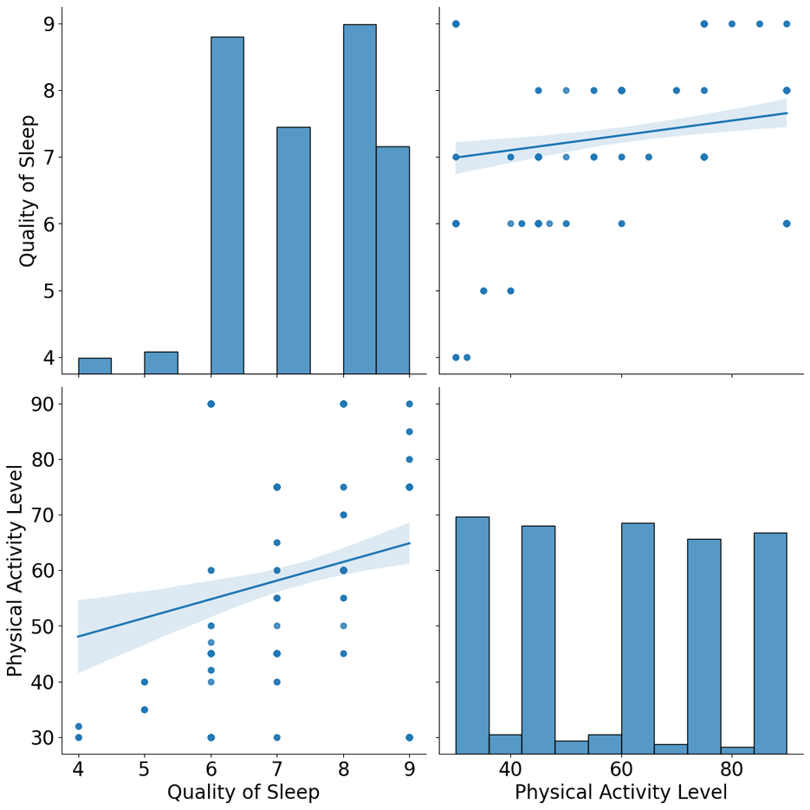
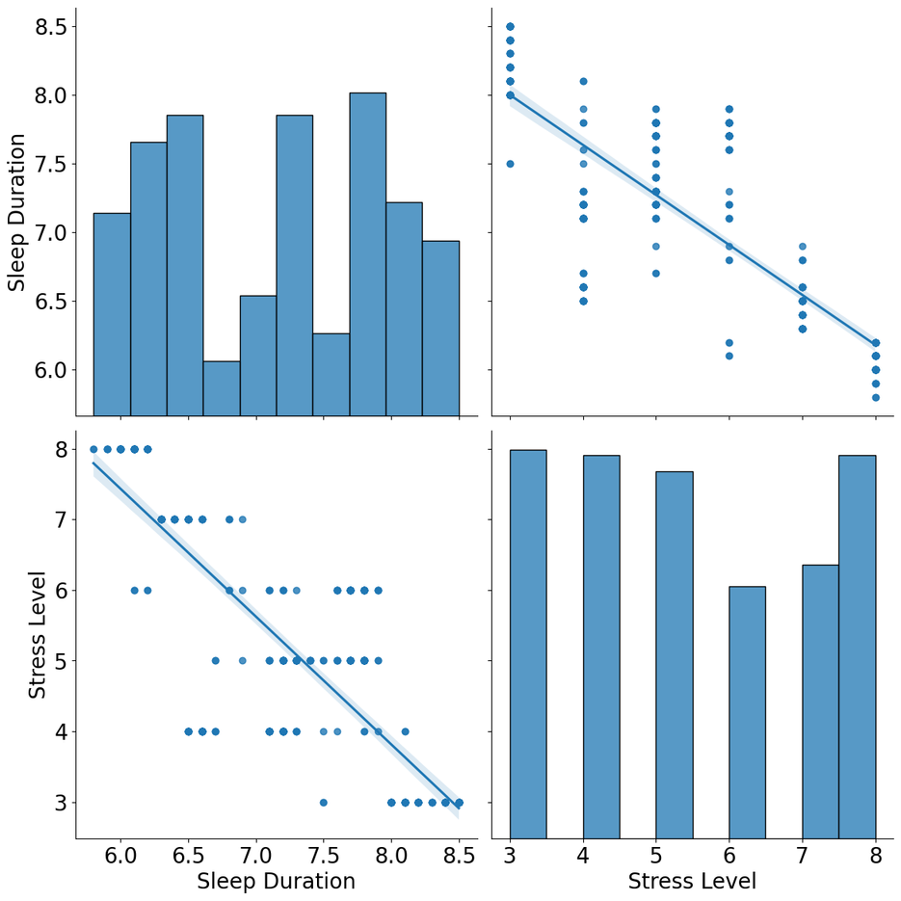
4) PAIR PLOTS
Sleep Duration - Sleep Level
Quality of Sleep - Physical Activity Level
08

Slide 10
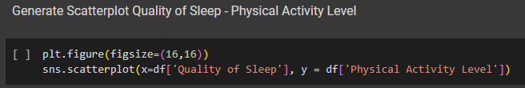
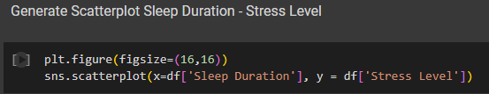
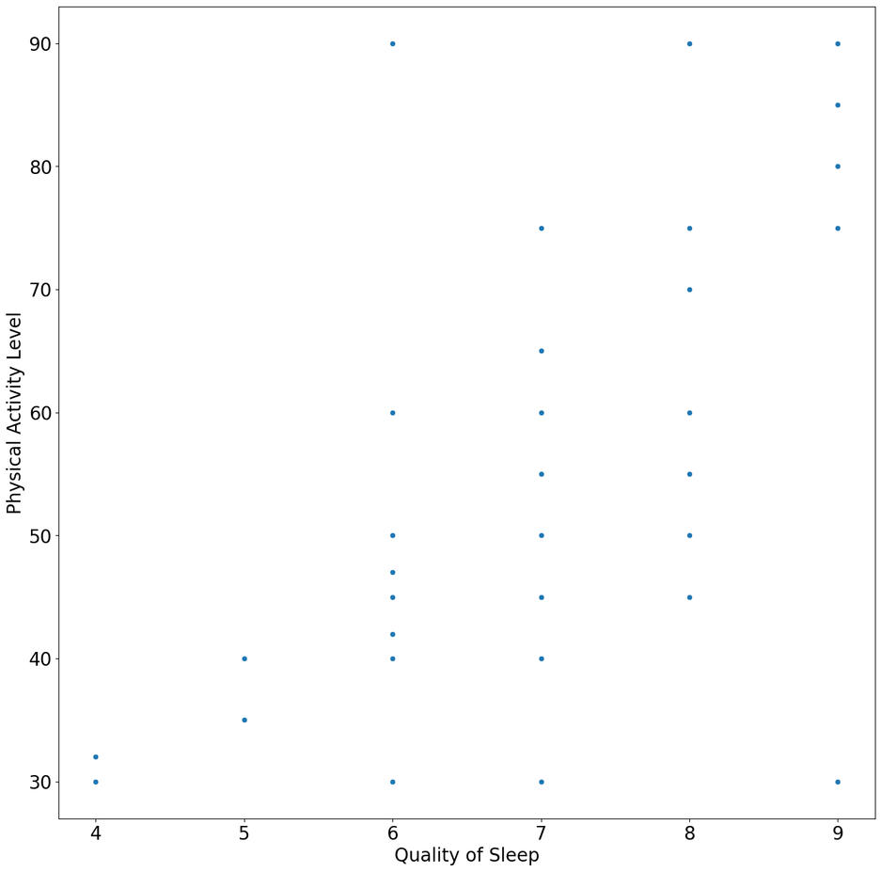
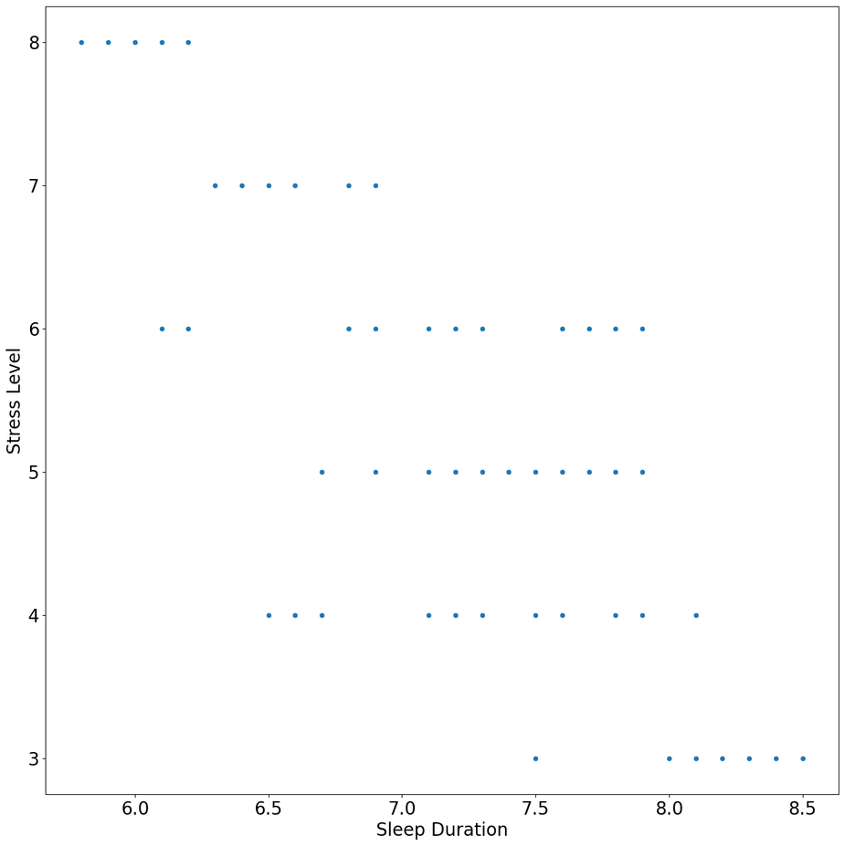
5) SCATTERPLOTS
09

Slide 11
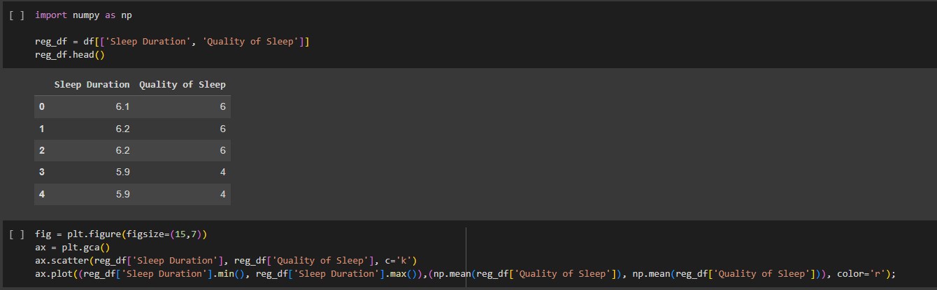
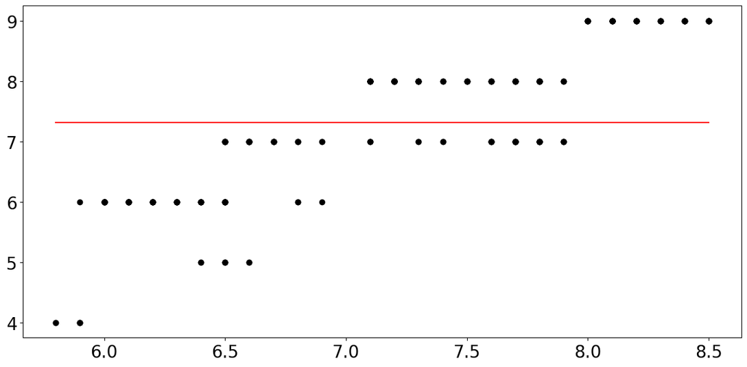
Sleep Duration - Quality of Sleep.
6) BASELINE PREDICTOR
10

Slide 12
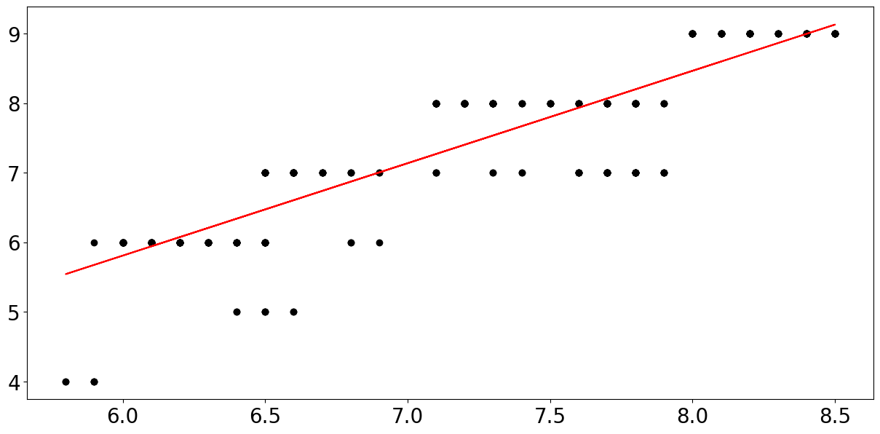
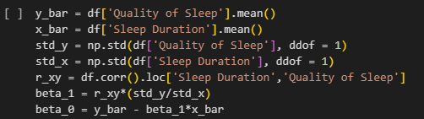
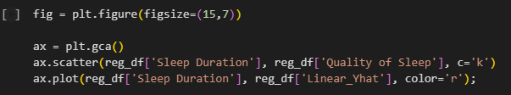
7) SIMPLE LINEAR REGRESSION MODEL
11

Slide 13
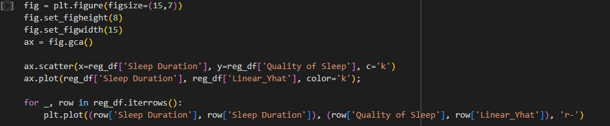
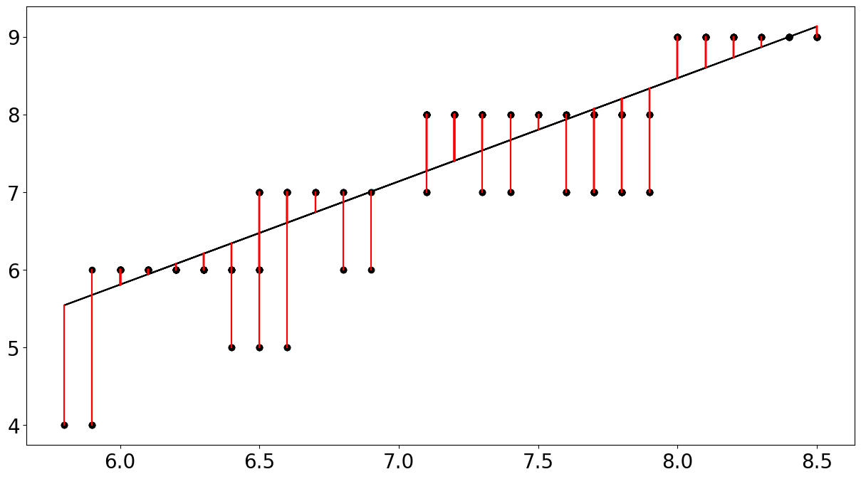
7) SIMPLE LINEAR REGRESSION MODEL
12

Slide 14
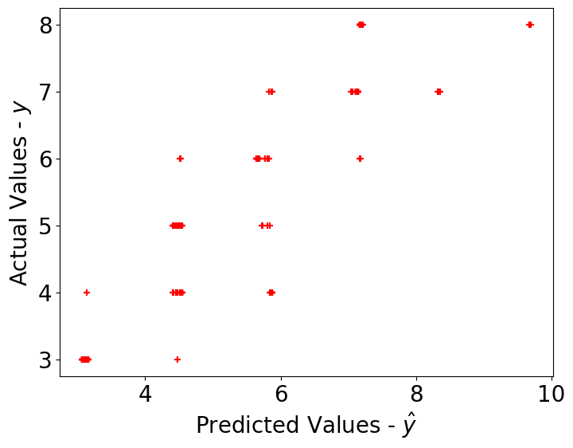
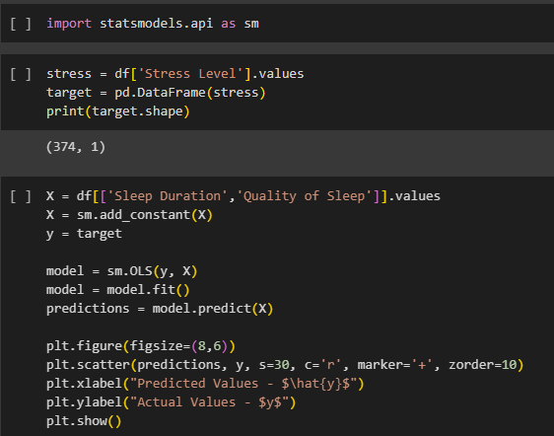
8) OLS REGRESSION MODEL
13

Slide 15
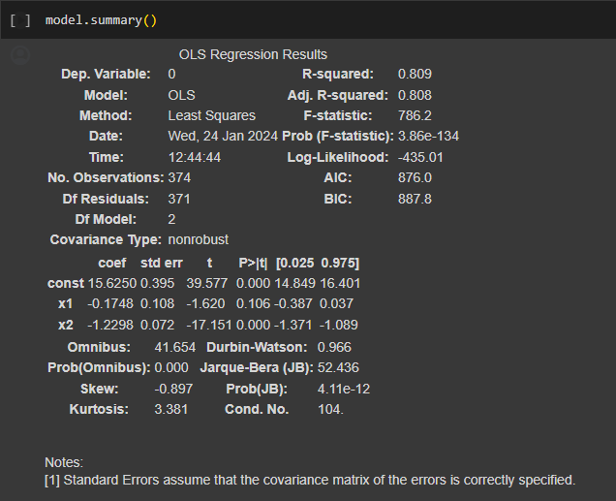
8) OLS REGRESSION MODEL SUMMARY
14

Slide 16

RESULTS & FINDINGS
Main Findings
The main findings suggest that the model demonstrated that approximately 80.9% of the variance in sleep quality could be explained by sleep duration and stress level. Stress level was found to be a significant predictor of sleep quality.
This study's findings underscore the significant impact of stress on sleep quality, highlighting the need for stress management interventions as part of a healthy lifestyle.
The pairplot indicates that sleep quality and physical activity level are generally positively correlated, with higher sleep quality being linked to higher levels of physical activity
15

Slide 17

RESULTS & FINDINGS
Limitations
Despite the strong model fit, the lack of normality in the residuals suggests that future research should incorporate a broader range of variables to fully capture the determinants of sleep quality.
The limitations of the research are mainly on the limited access to data and the lack of previous numerous researches on this topic, which needs to be further investigated due to the fact that human nature, behavior and lifestyle is changing due to the rapid changes in the environment.
16

Slide 18
THANK YOU!
Professors:
Petre Caraini
Daniel Traian Pele
Wolfgang Hardle
Team Members:
Research Methods - Project
IMBA, 2nd Year, 2023-2024
Torjescu Ana-Maria
Dumitru Laura-Alexandra
Costea Cristina-Bianca

